Slide 1
Ensemble Learning
https://www.mygreatlearning.com/blog/adaboost-algorithm/#:~:text=AdaBoost%20algorithm%2C%20short%20for%20Adaptive,assigned%20to%20incorrectly%20classified%20instances.

Slide 2
What is Ensemble Learning?
A common practice nowadays is to check the reviews of items before buying them.
And when checking reviews, you often look for the items with a large number of reviews so you could know for sure about its rating.
After going through the reviews from multiple people you decide whether to buy the item or not.
Ensemble models in machine learning operate on a similar idea. They combine the decisions from multiple models to improve the overall performance.
This approach allows for better predictive performance compared to a single model.
This is the reason why ensemble methods were placed first in many prestigious machine learning competitions, such as the Netflix Competition, KDD 2009, and Kaggle.

Slide 3
Ensemble learning
Using multiple learning algorithm together for the same task.
In statistics and machine learning, ensemble methods use multiple learning algorithms to obtain better predictive performance than could be obtained from any of the constituent learning algorithms alone
Better predictions than individual learning models.
Ensemble methods are techniques that create multiple models and then combine them to produce improved results.
The main causes of error in learning models are due to noise, bias and variance.

Slide 4
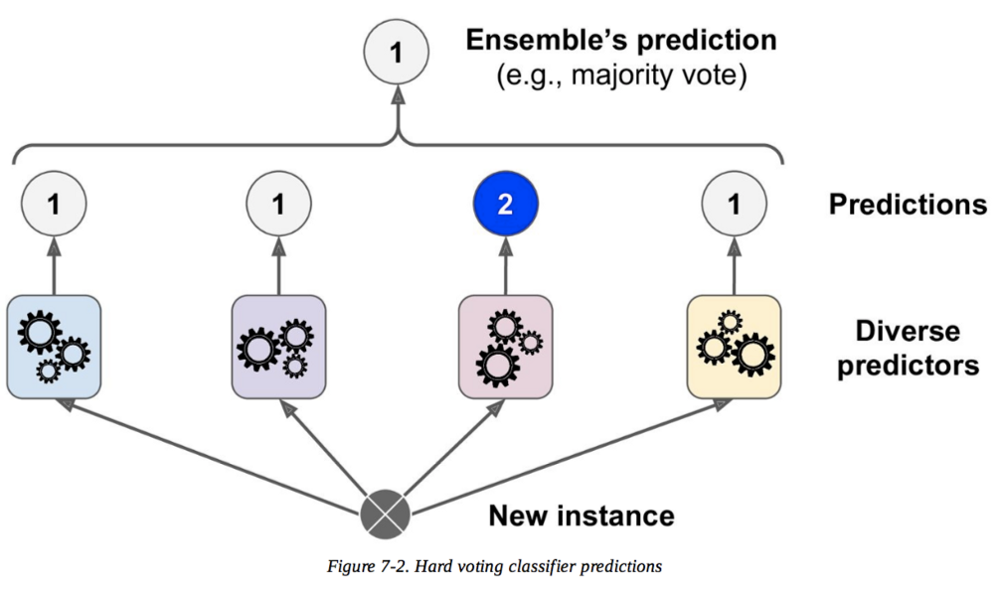
Voting or Averaging of predictions of multiple models

Slide 5
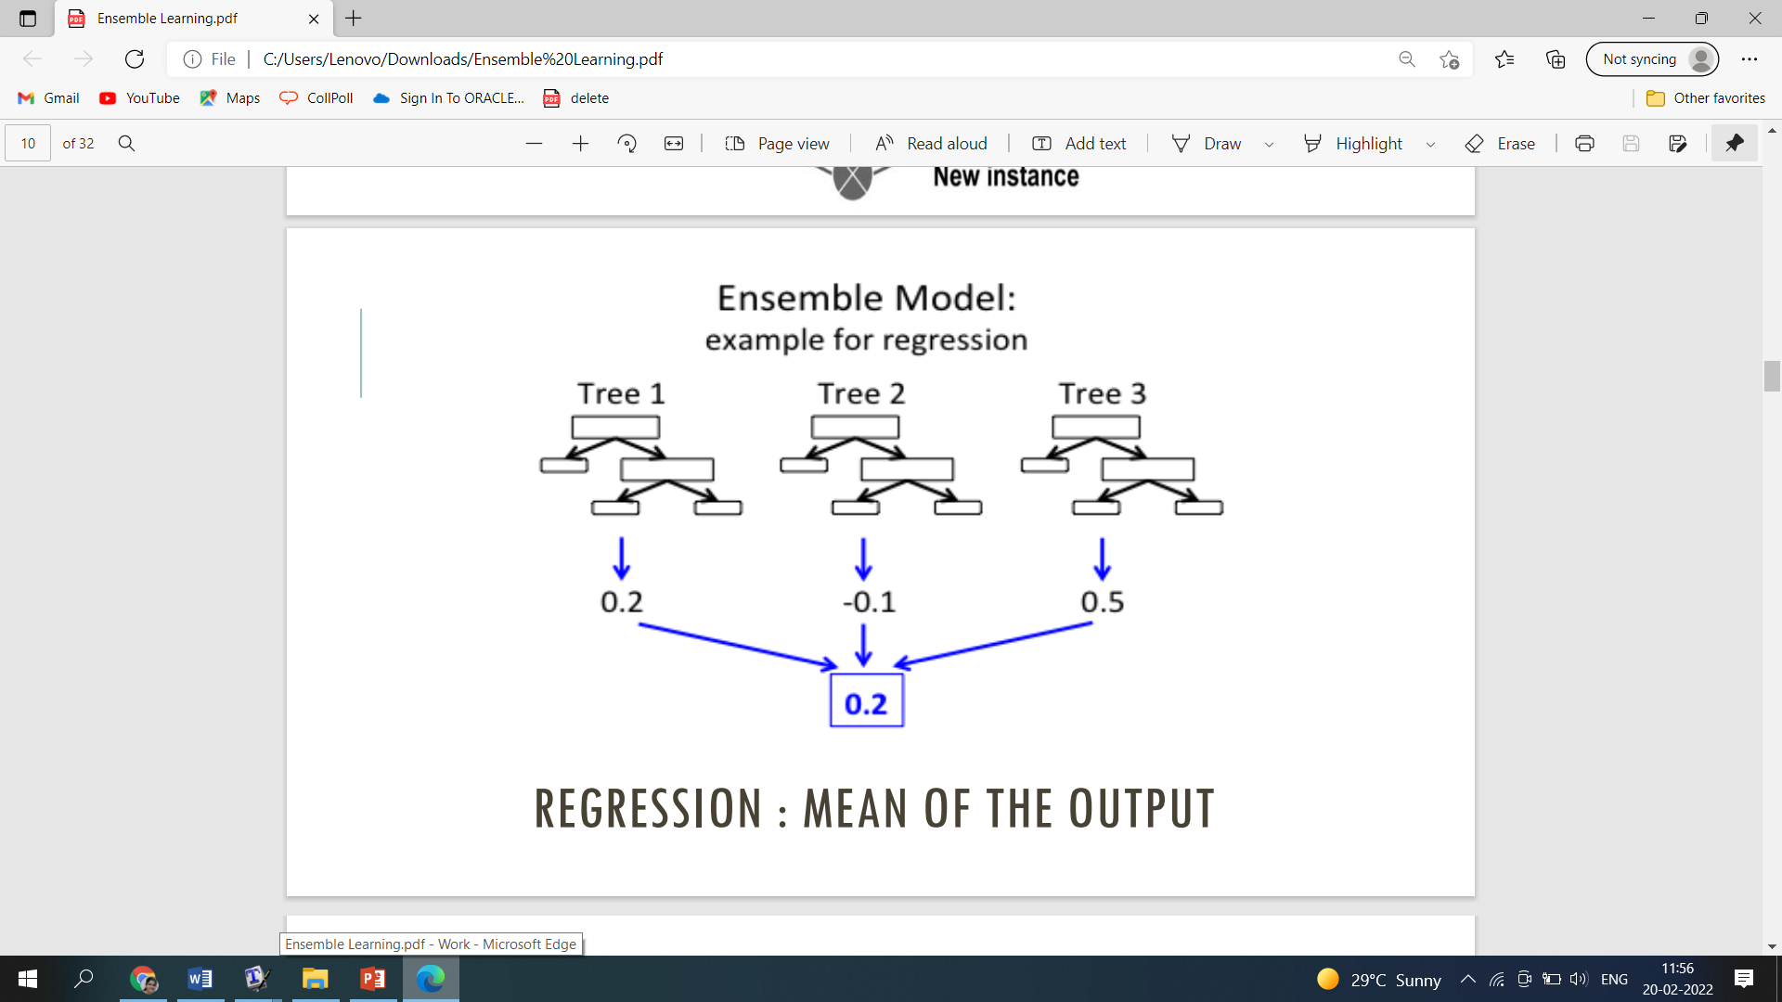
Ensemble Model Example of Regression

Slide 6
Significance of Ensemble Models
Why Use Ensemble Models?
Accuracy of Ensemble learner is suppose to be better than other algorithms
Better Accuracy (Low Error)
Higher Consistency (Avoid Over fitting)
Reduced Bias and Variance Errors
## Bias and variance references-
https://www.bmc.com/blogs/bias-variance-machine-learning/
WHEN AND WHERE TO USE ENSEMBLE MODELS?
Single model over fits
Result worth the extra training
Can be used for classification as well as regression

Slide 7
TWO GROUPS OF ENSEMBLE METHODS
Sequential Ensemble methods: the base learners are generated sequentially (e.g. AdaBoost)
To exploit the dependence between the base learners.
The overall performance can be boosted by weighing previously mislabeled examples with higher weight.
Parallel ensemble methods: the base learners are generated in parallel (e.g. Random Forest)
The basic motivation of parallel methods is to exploit interdependence between the base learners
The error can be reduced dramatically by averaging

Slide 8
ENSEMBLE METHODS
Homogeneous Ensembles: a single base learning algorithm to produce homogeneous base learners, i.e. learners of the same type, leading to homogeneous ensembles
Heterogeneous Ensembles: learners of different types, leading to heterogeneous ensembles
In order for ensemble methods to be more accurate than any of its individual members, the base learners have to be as accurate as possible and as diverse as possible.

Slide 9
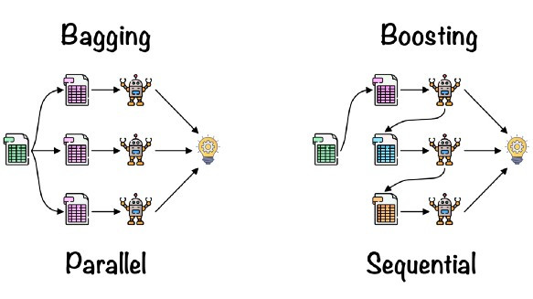

Slide 10
Bagging or Bootstrap Aggregation
Bagging or Bootstrap Aggregation was formally introduced by Leo Breiman in 1996.
Bagging is an Ensemble Learning technique which aims to reduce the error learning through the implementation of a set of homogeneous machine learning algorithms.
The key idea of bagging is the use of multiple base learners which are trained separately with a random sample from the training set, which through a voting or averaging approach, produce a more stable and accurate model.

Slide 11
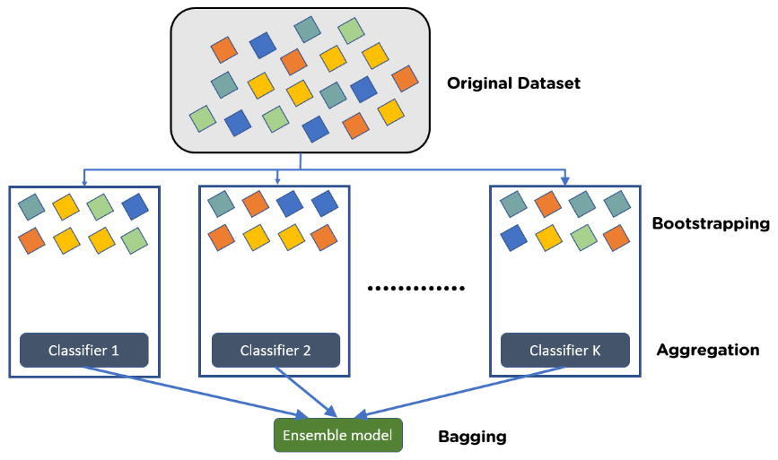
Bagging or Bootstrap Aggregation

Slide 12
Bagging or Bootstrap Aggregation
The main two components of bagging technique are: the random sampling with replacement (bootstraping) and the set of homogeneous machine learning algorithms (ensemble learning).
The bagging process is quite easy to understand, first it is extracted “n” subsets from the training set, then these subsets are used to train “n” base learners of the same type.The bagging is parallel ensemble approach.
For making a prediction, each one of the “n” learners are feed with the test sample, the output of each learner is averaged (in case of regression) or voted (in case of classification).

Slide 13
The most famous such approach is “bagging” (standing for “bootstrap aggregating”) that aims at producing an ensemble model that is more robust than the individual models composing it.
Bootstrapping
Let’s begin by defining bootstrapping. This statistical technique consists in generating samples of size B (called bootstrap samples) from an initial dataset of size N by randomly drawing with replacement B observations.

Slide 14
What Is Bootstrapping?
The bootstrapping is statistical technique consists in generating samples of size B (called bootstrap samples) from an initial dataset of size N by randomly drawing with replacement B observations.
Steps to Perform Bagging
Consider there are n observations and m features in the training set. You need to select a random sample from the training dataset without replacement
A subset of m features is chosen randomly to create a model using sample observations
The feature offering the best split out of the lot is used to split the nodes
The tree is grown, so you have the best root nodes
The above steps are repeated n times. It aggregates the output of individual decision trees to give the best prediction

Slide 15
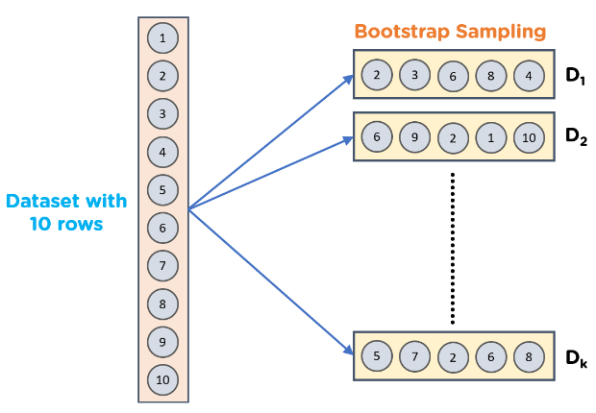
Advantages of Bagging in Machine Learning
Bagging minimizes the overfitting of data
It improves the model’s accuracy
It deals with higher dimensional data efficiently

Slide 16
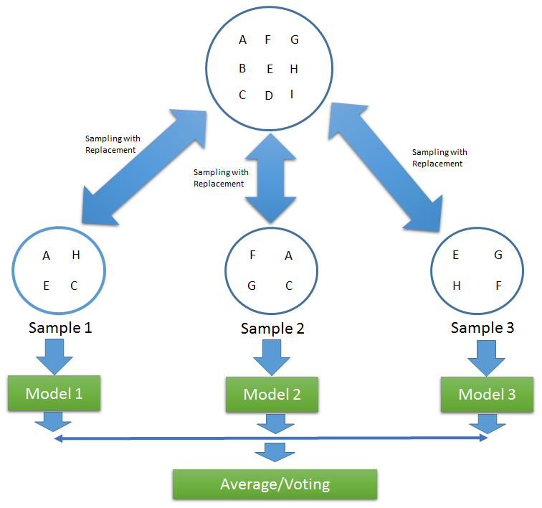

Slide 17
Bagging Model
Advantages of a Bagging Model:
1. Bagging significantly decreases the variance without increasing bias.
2. Bagging methods work so well because of diversity in the training data since the sampling is done by bootstrapping.
3. Also, if the training set is very huge, it can save computational time by training the model on a relatively smaller data set and still can increase the accuracy of the model.
4. Works well with small datasets as well.
· Disadvantages of a Bagging Model:
1. The main disadvantage of Bagging is that it improves the accuracy of the model at the expense of interpretability i.e., if a single tree was being used as the base model, then it would have a more attractive and easily interpretable diagram, but with the use of bagging this interpretability gets lost.
2. Another disadvantage of Bootstrap Aggregation is that during sampling, we cannot interpret which features are being selected i.e., there are chances that some features are never used, which may result in a loss of important information.

Slide 18
Random Forest
Random forest is one of the most popular tree-based supervised learning algorithms. It is also the most flexible and easy to use.
The algorithm can be used to solve both classification and regression problems. Random forest tends to combine hundreds of decision trees and then trains each decision tree on a different sample of the observations.
The final predictions of the random forest are made by averaging the predictions of each individual tree.
The benefits of random forests are numerous. The individual decision trees tend to overfit to the training data but random forest can mitigate that issue by averaging the prediction results from different trees. This gives random forests a higher predictive accuracy than a single decision tree.

Slide 19
Random forest Application
Random forest has been used in a variety of applications, for example to provide recommendations of different products to customers in e-commerce.
In medicine, a random forest algorithm can be used to identify the patient’s disease by analyzing the patient’s medical record.
Also in the banking sector, it can be used to easily determine whether the customer is fraudulent or legitimate.

Slide 20
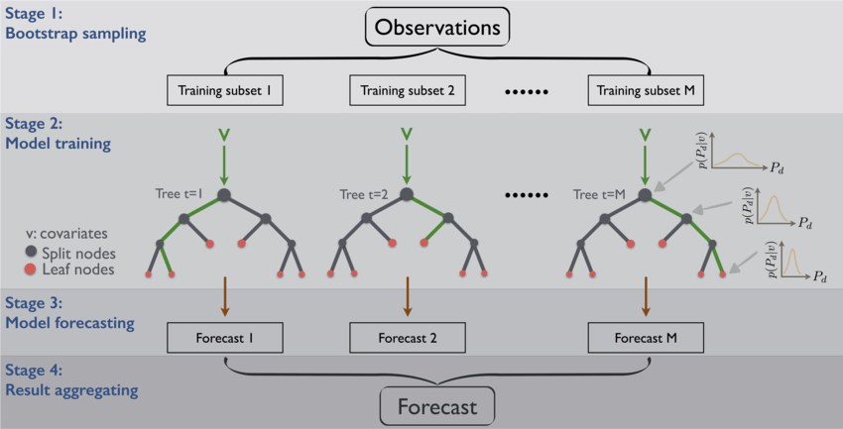
Random Forest

Slide 21
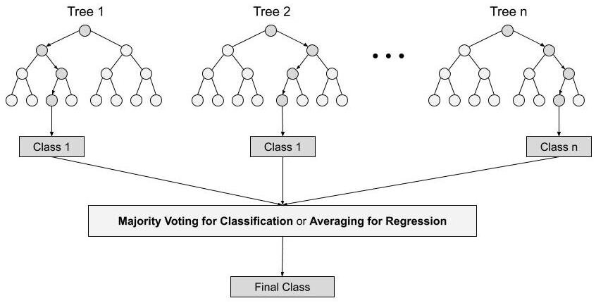
How does the Random Forest algorithm work?
Steps involved in random forest algorithm:
Step 1: In Random forest n number of random records are taken from the data set having k number of records.
Step 2: Individual decision trees are constructed for each sample.
Step 3: Each decision tree will generate an output.
Step 4: Final output is considered based on Majority Voting or Averaging for Classification and regression respectively.

Slide 22
Random Forest algorithm -Example
For example: consider the fruit basket as the data as shown in the figure below.
Now n number of samples are taken from the fruit basket and an individual decision tree is constructed for each sample.
Each decision tree will generate an output as shown in the figure.
The final output is considered based on majority voting.
In the below figure you can see that the majority decision tree gives output as an apple when compared to a banana, so the final output is taken as an apple.

Slide 23
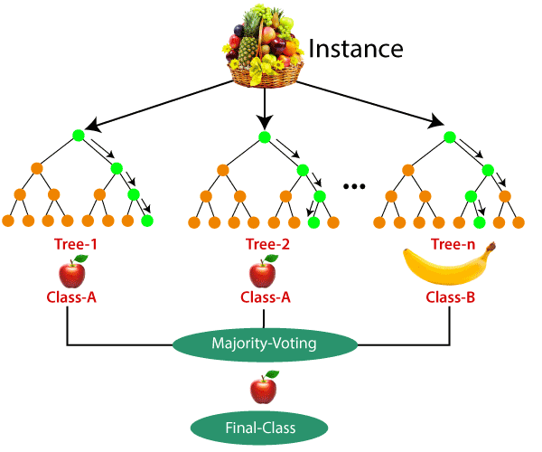

Slide 24
Difference Between Decision Tree & Random Forest
Random forest is a collection of decision trees; still, there are a lot of differences in their behavior
Decision trees | Random Forest
1. Decision trees normally suffer from the problem of overfitting if it’s allowed to grow without any control. | 1. Random forests are created from subsets of data and the final output is based on average or majority ranking and hence the problem of overfitting is taken care of.
2. A single decision tree is faster in computation. | 2. It is comparatively slower.
3. When a data set with features is taken as input by a decision tree it will formulate some set of rules to do prediction. | 3. Random forest randomly selects observations, builds a decision tree and the average result is taken. It doesn’t use any set of formulas.

Slide 25
Important Features of Random Forest
1. Diversity- Not all attributes/variables/features are considered while making an individual tree, each tree is different.
2. Immune to the curse of dimensionality- Since each tree does not consider all the features, the feature space is reduced.
3. Parallelization-Each tree is created independently out of different data and attributes. This means that we can make full use of the CPU to build random forests.
4. Train-Test split- In a random forest we don’t have to segregate the data for train and test as there will always be 30% of the data which is not seen by the decision tree.
5. Stability- Stability arises because the result is based on majority voting/ averaging

Slide 26
Important Hyperparameter of Random Forest
Hyperparameters are used in random forests to either enhance the performance and predictive power of models or to make the model faster.
Following hyperparameters increases the predictive power:
1. n_estimators– number of trees the algorithm builds before averaging the predictions.
2. max_features– maximum number of features random forest considers splitting a node.
3. mini_sample_leaf– determines the minimum number of leaves required to split an internal node.
Following hyperparameters increases the speed:
1. n_jobs– it tells the engine how many processors it is allowed to use. If the value is 1, it can use only one processor but if the value is -1 there is no limit.
2. random_state– controls randomness of the sample. The model will always produce the same results if it has a definite value of random state and if it has been given the same hyperparameters and the same training data.
3. oob_score – OOB means out of the bag. It is a random forest cross-validation method. In this one-third of the sample is not used to train the data instead used to evaluate its performance. These samples are called out of bag samples.

Slide 27
BOOSTING
Boosting refers to a family of algorithms that are able to convert weak learners to strong learners.
The main principle of boosting is to fit a sequence of weak learners− models that are only slightly better than random guessing, such as small decision trees− to weighted versions of the data.
More weight is given to examples that were misclassified by earlier rounds.
The predictions are then combined through a weighted majority vote (classification) or a weighted sum (regression) to produce the final prediction.
The principal difference between boosting and the committee methods, such as bagging, is that base learners are trained in sequence on a weighted version of the data.

Slide 28
Boosting
The Boosting algorithm then combines these multiple weak rules together to reduce variance and bias in individual model rules into a single prediction rule, such that it will be much more accurate than any one of the weak rules as.
The basic principle behind the working of the boosting algorithm is to generate multiple weak learners and combine their predictions to form one strong rule.
These weak rules are generated by applying base Machine Learning algorithms on different distributions of the data set.
These algorithms generate weak rules for each iteration.
After multiple iterations, the weak learners are combined to form a strong learner that will predict a more accurate outcome.
Two fundamental approaches for effective implementation of Boosting algorithm:
Choosing the different subsets from training dataset for different iterations:
To increase the efficiency of the base learner predictions, high weightage is placed on the examples that were misclassified by earlier weak learner.
How to combine weak leaners together:
Taking a weighted majority vote of the predictions.

Slide 29
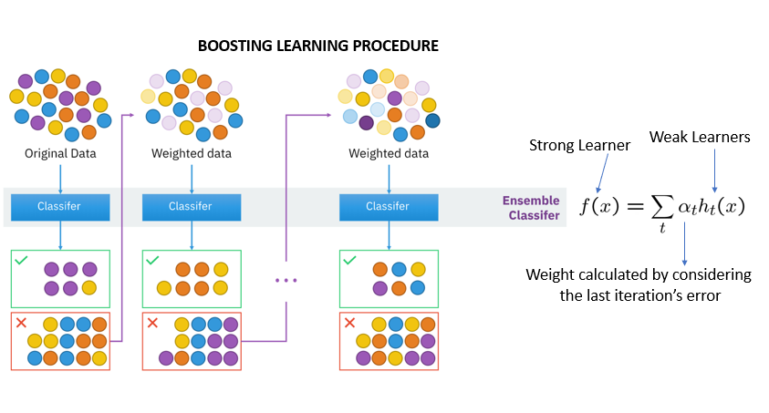

Slide 30
AdaBoost
Reference- https://www.youtube.com/watch?v=LsK-xG1cLYA
The idea of Boosting method is that instead of using a simple algorithm, which is not strong enough to make the accurate predictions alone as there are high variance and error rate, we combine multiple simple learning algorithms together, rather than finding a single highly accurate prediction rule.
Hence, we can say that Boosting algorithm is adaptive.
These simple algorithms are known as a weak learner, and Boosting algorithm calls this weak learner multiple times and feeding it a different subset of the training samples, such that each time the base learning algorithm generates a new weak prediction rule.

Slide 31
How the Ada Boost algorithm works:
Step 1: The base algorithm reads the data and assigns equal weight to each sample observation.
Step 2: False predictions made by the base learner are identified. In the next iteration, these false predictions are assigned to the next base learner with a higher weightage on these incorrect predictions.
Step 3: Repeat step 2 until the algorithm can correctly classify the output.
Therefore, the main aim of Boosting is to focus more on miss-classified predictions.
Now that we know how the boosting algorithm works, let’s understand the different types of boosting techniques.

Slide 32
AdaBoost
The boosting technique follows a sequential order. The output of one base learner will be input to another.
If a base classifier is misclassified (red box), its weight will get increased (over-weighting) and the next base learner will classify more correctly.
The next logical step is to combine the classifiers to predict the results.
Gradient Descent Boosting, AdaBoost, and XGboost are some extensions over boosting methods.
Gradient boosting minimizes the loss but adds gradient optimization in the iteration, whereas Adaptive Boosting, or AdaBoost, tweaks the instance of weights for every new predictor.

Slide 33
AdaBoost
First of all, AdaBoost is short for Adaptive Boosting. Basically, Ada Boosting was the first really successful boosting algorithm developed for binary classification
Generally, AdaBoost is used with short decision trees. Further, the first tree is created, the performance of the tree on each training instance is used.
Also, we use it to weight how much attention the next tree.
Thus, it is created should pay attention to each training instance. Hence, training data that is hard to predict is given more weight. Although, whereas easy to predict instances are given less weight.

Slide 34
Data Preparation for AdaBoost
Quality Data:
Because of the ensemble method attempt to correct misclassifications in the training data. Also, you need to be careful that the training data is high-quality.
Outliers:
Generally, outliers will force the ensemble down the rabbit hole of work. Although, it is so hard to correct for cases that are unrealistic. These could be removed from the training dataset.
Noisy Data:
Basically, noisy data, specifical noise in the output variable can be problematic. But if possible, attempt to isolate and clean these from your training dataset.

Slide 35
How Does AdaBoost Work?
Reference -https://www.mygreatlearning.com/blog/adaboost-algorithm/
First, let us discuss how boosting works. It makes ‘n’ number of decision trees during the data training period.
As the first decision tree/model is made, the incorrectly classified record in the first model is given priority.
Only these records are sent as input for the second model.
The process goes on until we specify a number of base learners we want to create.
Remember, repetition of records is allowed with all boosting techniques.

Slide 36
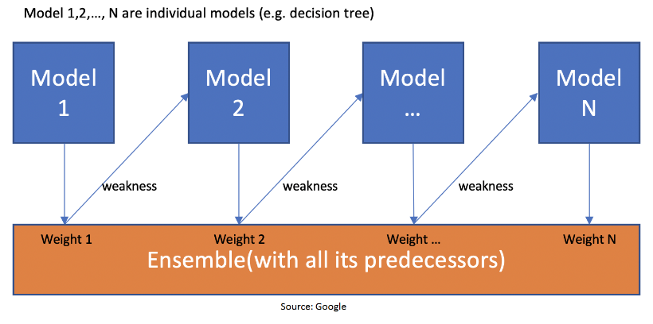
This figure shows how the first model is made and errors from the first model are noted by the algorithm. The record which is incorrectly classified is used as input for the next model.
This process is repeated until the specified condition is met.
As you can see in the figure, there are ‘n’ number of models made by taking the errors from the previous model.
This is how boosting works. The models 1,2, 3,…, N are individual models that can be known as decision trees. All types of boosting models work on the same principle.

Slide 37
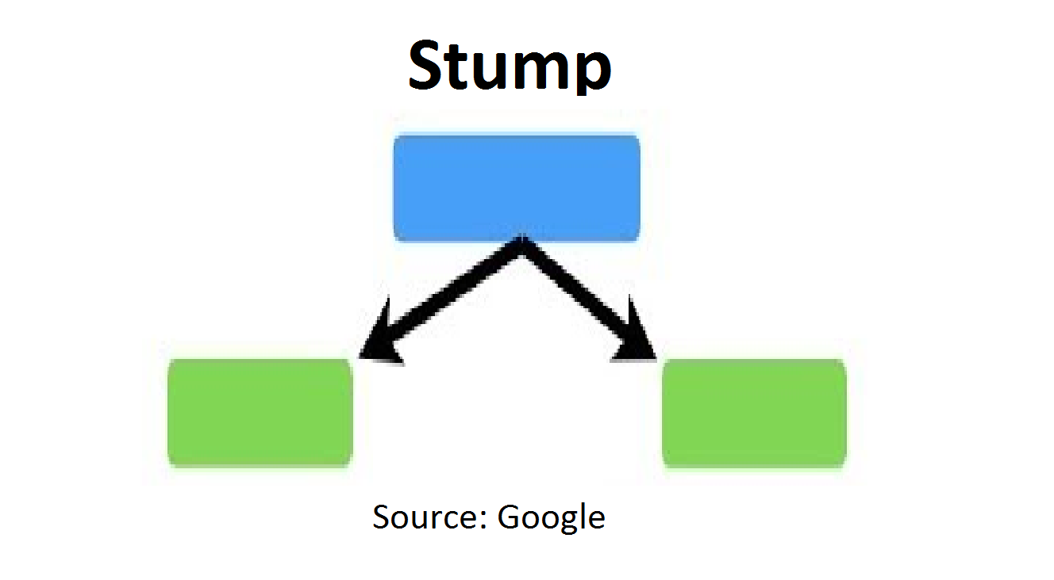
Since we now know the boosting principle, it will be easy to understand the AdaBoost algorithm.
Let’s dive into AdaBoost’s working. When the random forest is used, the algorithm makes an ‘n’ number of trees.
It makes proper trees that consist of a start node with several leaf nodes. Some trees might be bigger than others, but there is no fixed depth in a random forest.
With AdaBoost, however, the algorithm only makes a node with two leaves, known as Stump.
The figure here represents the stump. It can be seen clearly that it has only one node with two leaves. These stumps are weak learners and boosting techniques prefer this. The order of stumps is very important in AdaBoost

Slide 38
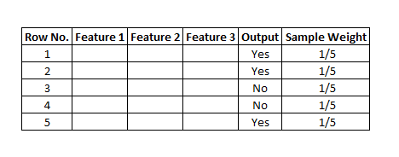
Here’s a sample dataset consisting of only three features where the output is in categorical form.
The image shows the actual representation of the dataset. As the output is in binary/categorical form, it becomes a classification problem.
In real life, the dataset can have any number of records and features in it.
Let us consider 5 datasets for explanation purposes. The output is in categorical form, here in the form of Yes or No. All these records will be assigned a sample weight.
The formula used for this is ‘W=1/N’ where N is the number of records. In this dataset, there are only 5 records, so the sample weight becomes 1/5 initially.
Every record gets the same weight. In this case, it’s 1/5.

Slide 39
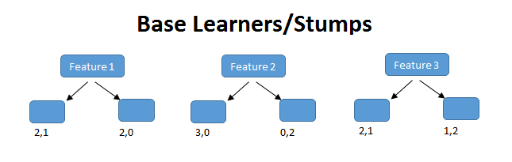
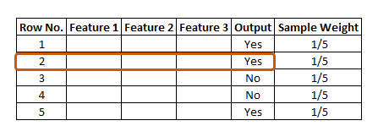
Step 1 – Creating the First Base Learner
To create the first learner, the algorithm takes the first feature, i.e., feature 1 and creates the first stump, f1. It will create the same number of stumps as the number of features. In the case below, it will create 3 stumps as there are only 3 features in this dataset.
From these stumps, it will create three decision trees. This process can be called the stumps-base learner model. Out of these 3 models, the algorithm selects only one. Two properties are considered while selecting a base learner – Gini and Entropy.
We must calculate Gini or Entropy the same way it is calculated for decision trees. The stump with the least value will be the first base learner. In the figure below, all the 3 stumps can be made with 3 features.
The number below the leaves represents the correctly and incorrectly classified records. By using these records, the Gini or Entropy index is calculated.
The stump that has the least Entropy or Gini will be selected as the base learner. Let’s assume that the entropy index is the least for stump 1. So, let’s take stump 1, i.e., feature 1 as our first base learner.
Here, feature (f1) has classified 2 records correctly and 1 incorrectly. The row in the figure that is marked red is incorrectly classified. For this, we will be calculating the total error.

Slide 40
Step 2 – Calculating the Total Error (TE)
The total error is the sum of all the errors in the classified record for sample weights. In our case, there is only 1 error, so Total Error (TE) = 1/5.

Slide 41

Step 3 – Calculating Performance of the Stump
Formula for calculating Performance of the Stump is: –
Performance of Stump Formula
where, ln is natural log and TE is Total Error.
In our case, TE is 1/5. By substituting the value of total error in the above formula and solving it, we get the value for the performance of the stump as 0.693. Why is it necessary to calculate the TE and performance of a stump?
The answer is, we must update the sample weight before proceeding to the next model or stage because if the same weight is applied, the output received will be from the first model.
In boosting, only the wrong records/incorrectly classified records would get more preference than the correctly classified records. Thus, only the wrong records from the decision tree/stump are passed on to another stump.
Whereas, in AdaBoost, both records were allowed to pass and the wrong records are repeated more than the correct ones.
We must increase the weight for the wrongly classified records and decrease the weight for the correctly classified records. In the next step, we will be updating the weights based on the performance of the stump.

Slide 42
Step 4 – Updating Weights
For incorrectly classified records, the formula for updating weights is:
New Sample Weight = Sample Weight * e^(Performance)
In our case Sample weight = 1/5 so, 1/5 * e^ (0.693) = 0.399
For correctly classified records, we use the same formula with the performance value being negative. This leads the weight for correctly classified records to be reduced as compared to the incorrectly classified ones. The formula is:
New Sample Weight = Sample Weight * e^- (Performance)
Putting the values, 1/5 * e^-(0.693) = 0.100

Slide 43
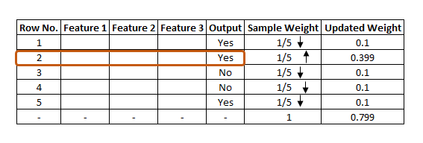
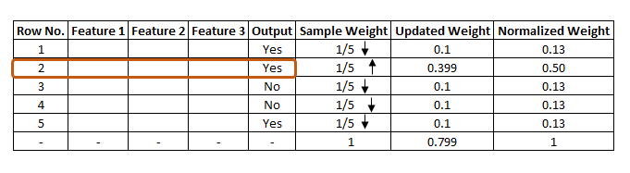
The updated weight for all the records can be seen in the figure. As is known, the total sum of all the weights should be 1.
In this case, it is seen that the total updated weight of all the records is not 1, it’s 0.799. To bring the sum to 1, every updated weight must be divided by the total sum of updated weight.
For example, if our updated weight is 0.399 and we divide this by 0.799, i.e. 0.399/0.799=0.50.
0.50 can be known as the normalized weight. In the below figure, we can see all the normalized weight and their sum is approximately 1.

Slide 44
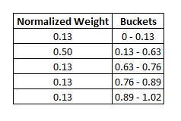
Step 5 – Creating a New Dataset
Now, it’s time to create a new dataset from our previous one. In the new dataset, the frequency of incorrectly classified records will be more than the correct ones. The new dataset has to be created using and considering the normalized weights. It will probably select the wrong records for training purposes. That will be the second decision tree/stump. To make a new dataset based on normalized weight, the algorithm will divide it into buckets.
So, our first bucket is from 0 – 0.13, second will be from 0.13 – 0.63(0.13+0.50), third will be from 0.63 – 0.76(0.63+0.13), and so on. After this the algorithm will run 5 iterations to select different records from the older dataset. Suppose in the 1st iteration, the algorithm will take a random value 0.46 to see which bucket that value falls into and select that record in the new dataset. It will again select a random value, see which bucket it is in and select that record for the new dataset. The same process is repeated 5 times.
There is a high probability for wrong records to get selected several times. This will form the new dataset. It can be seen in the image below that row number 2 has been selected multiple times from the older dataset as that row is incorrectly classified in the previous one.

Slide 45
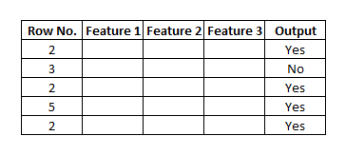
Based on this new dataset, the algorithm will create a new decision tree/stump and it will repeat the same process from step 1 till it sequentially passes through all stumps and finds that there is less error as compared to normalized weight that we had in the initial stage.

Slide 46
Stacking
Model stacking is an efficient ensemble method in which the predictions, generated by using various machine learning algorithms, are used as inputs in a second-layer learning algorithm.
This second-layer algorithm is trained to optimally combine the model predictions to form a new set of predictions.
For example, when linear regression is used as second-layer modeling, it estimates these weights by minimizing the least square errors.
However, the second-layer modeling is not restricted to only linear models; the relationship between the predictors can be more complex, opening the door to employing other machine learning algorithms.

Slide 47
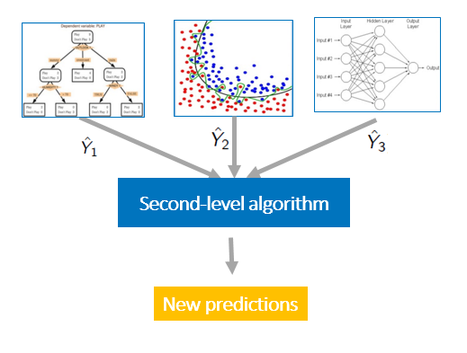
Stacking
Model stacking uses a second-level algorithm to estimate prediction weights in the ensemble model.

Slide 48
Stacking
In the standard stacking procedure, the first-level classifiers are fit to the same training set that is used prepare the inputs for the second-level classifier, which may lead to overfitting.
The StackingCVClassifier, however, uses the concept of cross-validation: the dataset is split into k folds, and in k successive rounds, k-1 folds are used to fit the first level classifier; in each round, the first-level classifiers are then applied to the remaining 1 subset that was not used for model fitting in each iteration.
The resulting predictions are then stacked and provided -- as input data -- to the second-level classifier. After the training of the StackingCVClassifier, the first-level classifiers are fit to the entire dataset as illustrated in the figure below.

Slide 49
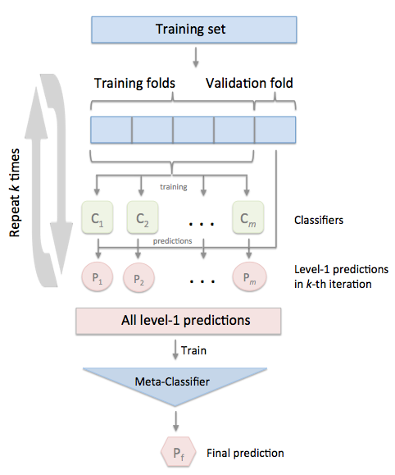
Stacking

Slide 50
How Does the Algorithm Decide Output for Test Data?
Suppose with the above dataset, the algorithm constructed 3 decision trees or stumps. The test dataset will pass through all the stumps which have been constructed by the algorithm. While passing through the 1st stump, the output it produces is 1. Passing through the 2nd stump, the output generated once again is 1. While passing through the 3rd stump it gives the output as 0. In the AdaBoost algorithm too, the majority of votes take place between the stumps, in the same way as in random trees. In this case, the final output will be 1. This is how the output with test data is decided.

Slide 51
